Slide 1
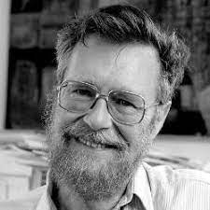
Dijkstra’s Algorithm
Invented by Edsger W. Dijkstra of the Netherlands
Presented by Cade Nichols

Slide 2
What it does exactly
Designed to find the shortest path between any two nodes in a weighted graph
works by maintaining a priority queue of unexplored nodes
then repeatedly selects the shortest path from the source node to that node
then visits all neighbors of the selected node
updates their distance
adds them to the queue
Repeats until queue is empty, or destination is reached

Slide 3
Prerequisites to make it work
All edges must be non-negative
There are distance values assigned to all node relationships
The source node must first be added to the priority queue
Double check that the priority queue is not empty
Use a heap data structure
Efficient in insertion and removal of elements

Slide 4
Steps to accomplish the algorithm
Remove the node with the lowest distance from the priority queue
For each neighbor of the current node:
calculate the distance to that neighbor
add the weight of the distance to the current node to the edge connecting the current node to the neighbor
If the distance is less than the current distance assigned to the neighbor:
update the neighbor's distance to the tentative distance.
Add neighbor to priority queue
Repeat until queue is empty or destination node is removed from the queue

Slide 5
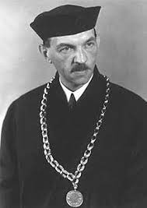
Prim’s Algorithm
Invented by Vojtěch Jarník of the czech republic
Presented by Cade Nichols

Slide 6
Uses Greed
used to find the Minimum Spanning Tree of a weighted undirected graph
An MST is a subset of the edges of a graph
It connects all the vertices together and it does so:
without any cycles
has the minimum possible total edge weight
Uses a priority queue data structure for efficiency
Time efficiency of this algorithm is O(ElogV)
E = # of edges
V = # of vertices

Slide 7
How to implement
pick a random vertex and add it to the MST
find the smallest weight edge that connects the MST to a vertex
Vertex must not be already inside the MST
add the vertex that weight is connected to to the MST
repeat until all vertices have been added

